Slide 1





Coursera Capstone Project
By: Shady Sakhel

Slide 2
Introduction
Did you know that on average 3,700 people lose their lives everyday due to road accidents?
That is 1.35 million people a year! Not only that, another 50 million people suffer long term disabilities!
We would like to have a model that can predict the severity of a road accident given the weather and road conditions
The model can warn drivers before they decide to begin their journey about the risk they are about to take

Slide 3
Data Acquisition & Cleaning
Data is collected from Seattle SPOT Traffic Management Division for all accidents between 2004 to present
The data set we selected has 194,673 rows and 37 different independent attributes
The data set was cleaned from useless attributes, repeated information and missed information
11 independent attributes were finally used for evaluation
A training and testing sets were created based on a 30% testing and a 70% training split

Slide 4
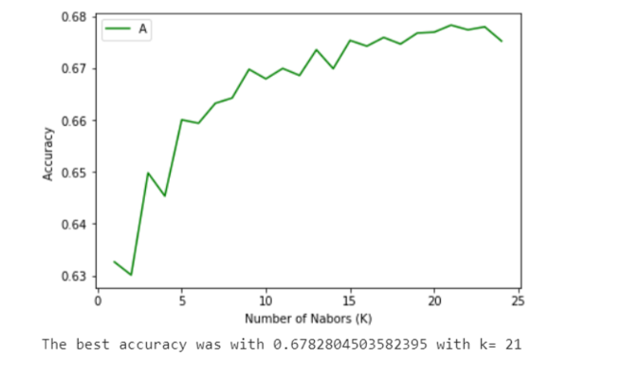
K-Nearest Neighbors

Slide 5
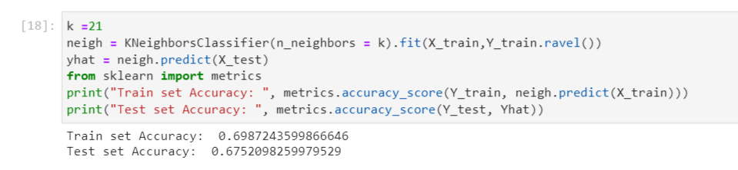
K-Nearest Neighbors
We can see that the best accuracy is with a K value of 21.

Slide 6
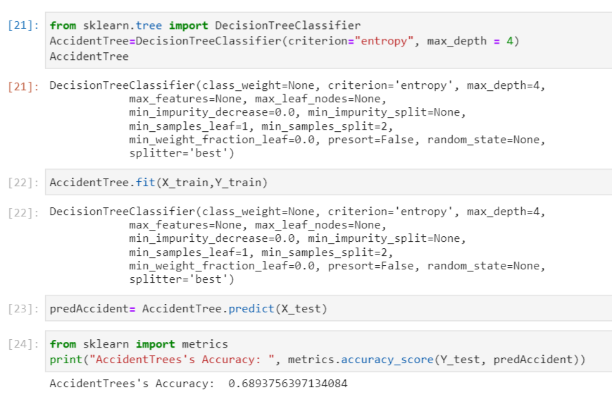
Decision Tree

Slide 7
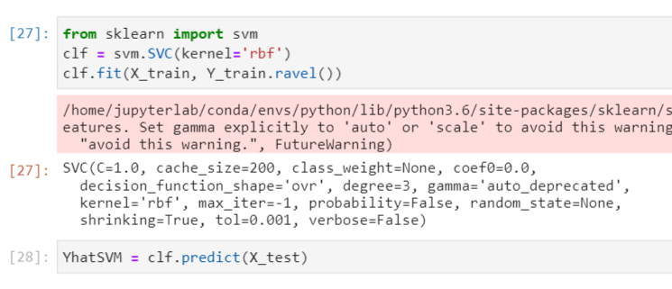
Support Vector Machine

Slide 8
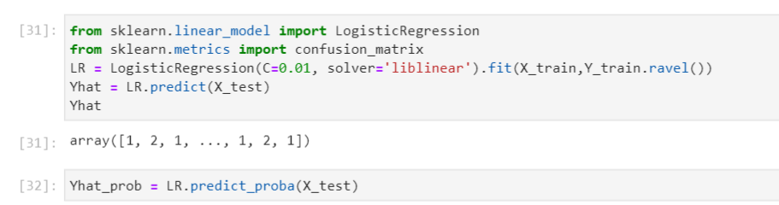
Logistic Regression

Slide 9
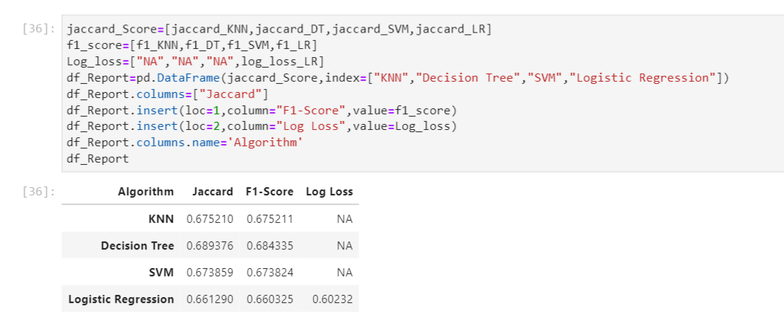
Model Comparison

Slide 10
Conclusion
The best accuracy is with the Decision Tree with a 69% accuracy
The model is underfitted and still needs improvement, but we need more data

